Slide 1
Dutch National Flag Algorithm
Name : Omar Yasser Saeed
ID : 222575

Slide 2
What is Dutch national flag problem?
DNF problem, is a computer science problem related to sorting algorithm. It's named after the flag of the Netherlands, which consists of three horizontal stripes of red, white, and blue
The task is to rearrange the elements so that all elements of the same value are grouped together, mimicking the layout of the Dutch flag.

Slide 3
strategy
Divide and conquer
The Dutch National Flag algorithm uses a linear partitioning strategy to sort an array containing three distinct values (often represented as 0s, 1s, and 2s) in a single pass through the array. The strategy involves organizing the array elements into three partitions to group elements of each distinct value together.

Slide 4
How can we solve the Dutch national flag problem?
Initialize Pointers: Use three pointers: low, mid, and high.
low points to the start of the array
mid also starts at 0
high point to the end of the array

Slide 5
How can we solve the Dutch national flag problem?
2.Traverse the Array:
Use the mid pointer to iterate through the array.
While mid is less than or equal to high:
If the element at index mid is 0:
Swap the element at index low with the element at index mid.
Increment both low and mid.
If the element at index mid is 1:
Move to the next element by incrementing mid.
If the element at index mid is 2:
Swap the element at index mid with the element at index high.
Decrement high to move towards the beginning of the array.
This process continues until mid crosses high, ensuring the array is sorted according to the Dutch National Flag problem conditions.

Slide 6
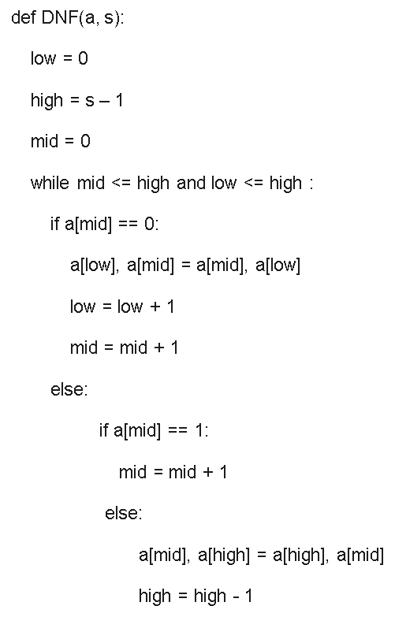
Implementation code

Slide 7

Space and Time complexity
The Dutch National Flag algorithm, used to solve the Dutch National Flag problem, operates in linear time complexity, which is O(n), where 'n' is the number of elements in the input array.
The algorithm scans the array exactly once, processing each element either by swapping it with another element or by adjusting the pointers. Regardless of the size of the input array, the algorithm processes each element once, ensuring a time complexity proportional to the number of elements in the array.
The space complexity of the Dutch National Flag algorithm is O(1), meaning it uses constant space regardless of the input array size. The algorithm achieves this by performing in-place rearrangements of the elements within the given array, without requiring any additional data structures or memory proportional to the input size.
Basic Operation: Comparison
Problem size : n
T(n) = $\sum_{k=0}^{n−1}{ 1}$
T(n) = upper – lower + 1
T(n) = n – 1 – 0 + 1
T(n) = n
= O(n)

Slide 8
Pros and cons of the Dutch national flag algorithm
Pros
Cons
Efficiency: The algorithm sorts an array containing three distinct values (e.g., 0s, 1s, and 2s) in linear time complexity O(n), where 'n' is the number of elements in the array. This makes it highly efficient, especially for large datasets.
In-Place Sorting: It operates in-place, meaning it rearranges the elements within the given array without requiring additional space. This makes it memory efficient, utilizing only constant space O(1).
Simple and Easy Implementation: The algorithm's logic is relatively straightforward and easy to implement. It involves traversing the array once and performing swaps based on comparisons, making it accessible to understand and code.
Not Stable: The algorithm is not a stable sort. If the relative order of equal elements matters, the Dutch National Flag algorithm might not preserve that order.
Limited to Three Values: The algorithm is specifically designed for sorting arrays containing three distinct values. If the problem involves more diverse or different values, the algorithm might not be suitable.

Slide 9
Reference List
GeeksforGeeks. "Dutch National Flag Problem." URL: GeeksforGeeks - Dutch National Flag Problem
Levitin, A. (Year). Introduction to the Design and Analysis of Algorithms. Publisher.
LeetCode. "Dutch National Flag Problem Discussion." URL: LeetCode - Dutch National Flag Problem

Slide 10
Thanks!

